Slide 1
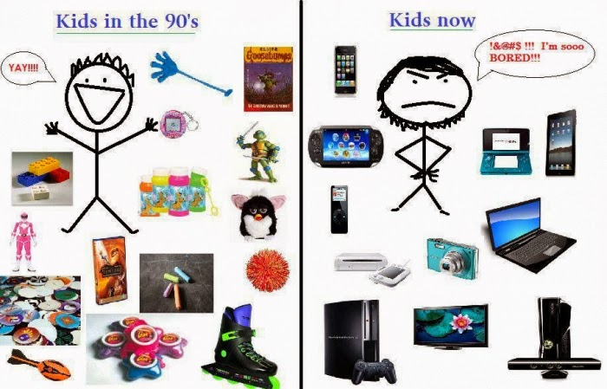

Slide 2


Slide 3

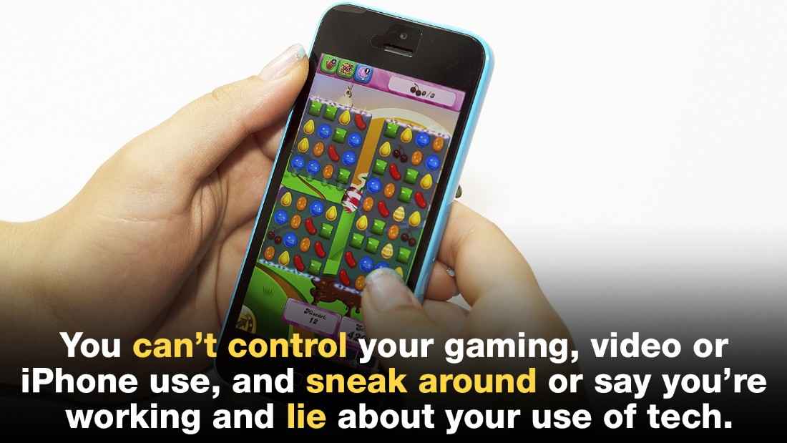
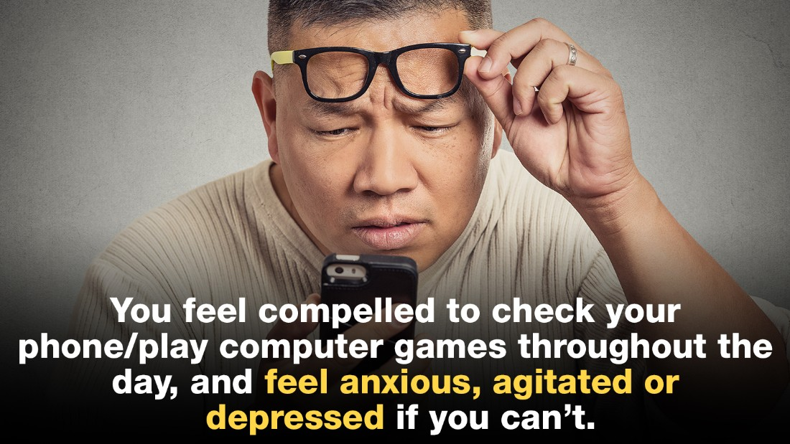
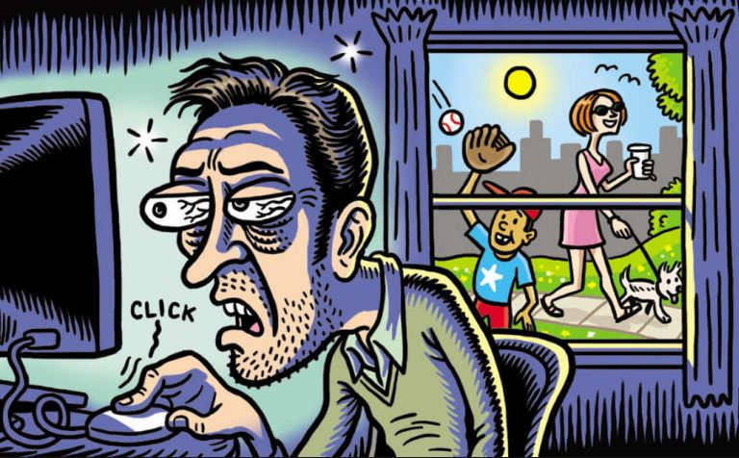
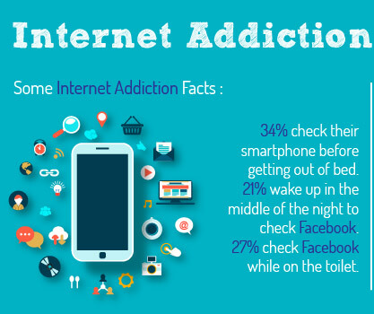
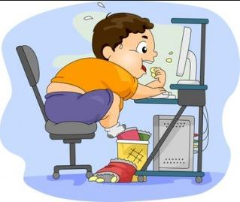

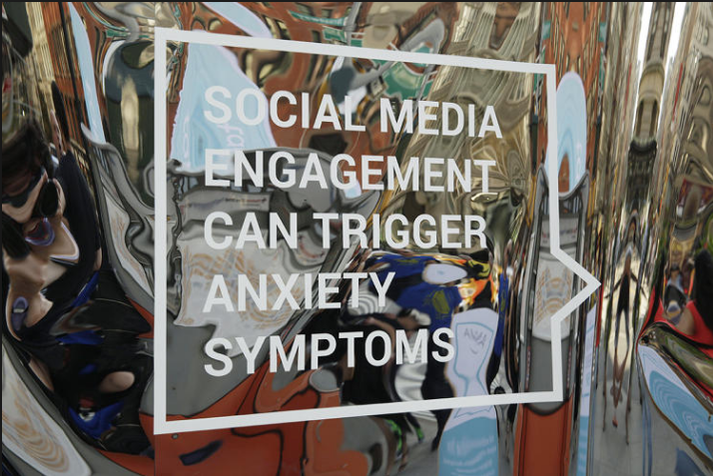
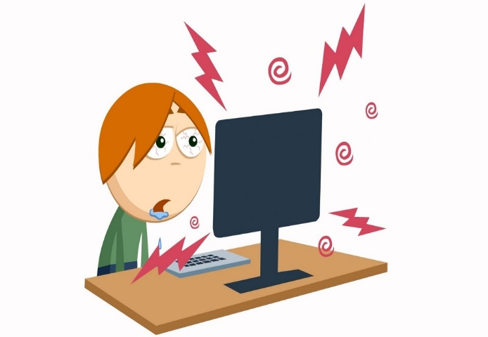


Slide 4
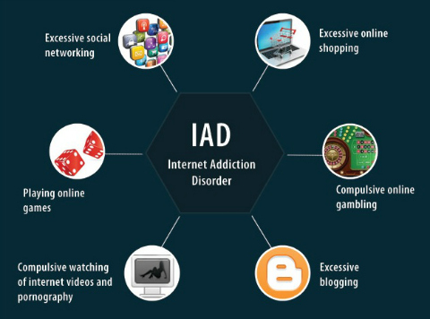
Cybersexual addiction
Cyber-relationship addiction
Net compulsions
Information overload
Gaming Addiction
https://www.youtube.com/watch?v=2WrmQ2SHaxM

Slide 5
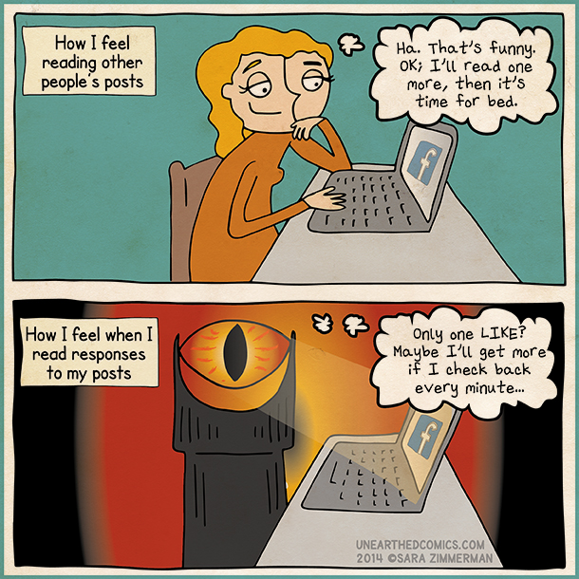
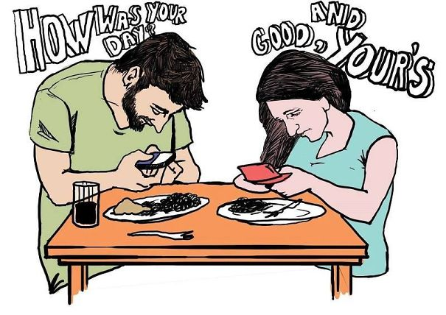
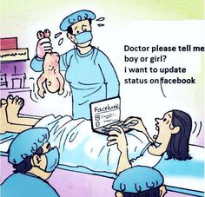
Psychological Disorder -withdrawal symptoms -affective disturbances -less social interaction -weakened family bonds -fake identities
SOCIAL MEDIA ADDICTION
https://www.youtube.com/watch?v=Vsq95M_kzWY
“The more time we spend interconnected via a myriad of devices, the less time we have left to develop true friendships in the real world”

Slide 6
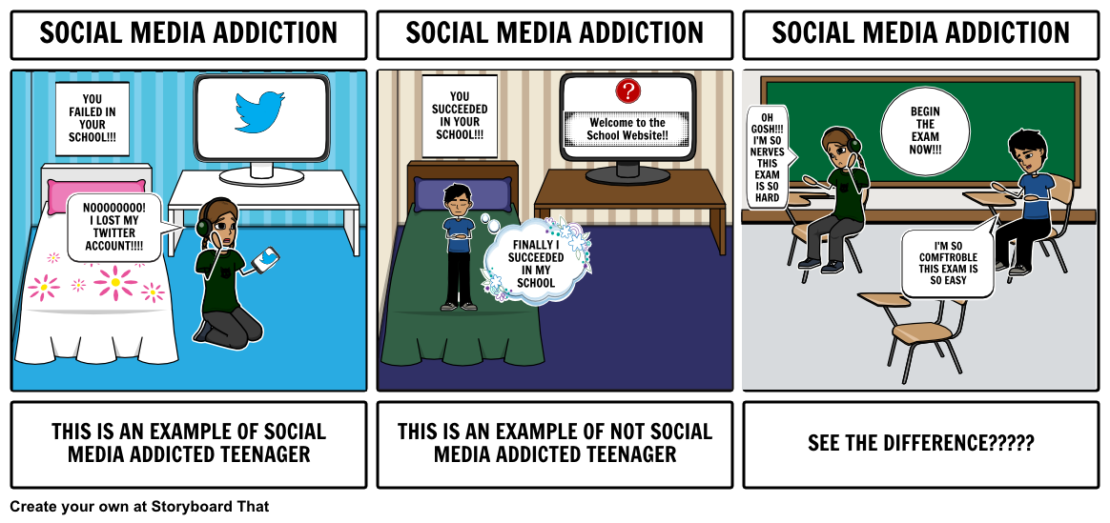
Understand - You are being played
Schedule and stick
Check with purpose
Respond offline
Alter your settings
Delete extra people from your friend list
Be a tough editor

Slide 7
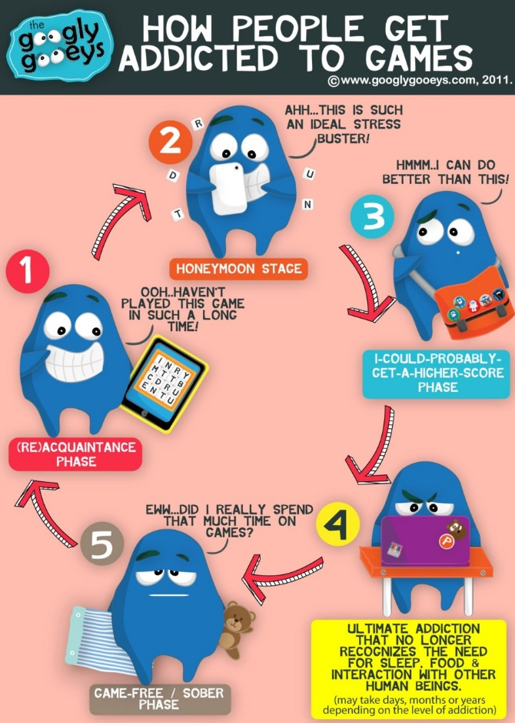

GAMING ADDICTION
-Refuse to go to school -Feel more comfortable in the virtual world -Lie about how often they play -Spend money on games instead of necessities -Constantly think about the game when not playing -Become depressed or angry when not playing

Slide 8
Excess playing time
Social isolation
Decide what is acceptable in your home
Check the ratings of the game before you buy it
Pick games that require the player to come up with strategies, and make decisions
Look for games involving multiple players to improve group activity
Cost
Separation from reality
Impact on education
Wrong values
Monitor video game play
Give children a variety of entertaining -things to learn from
Limit online game time
Monitor the effects of games on child
Long term concentration issues
Imitating violent games
Committing violent acts in life

Slide 9
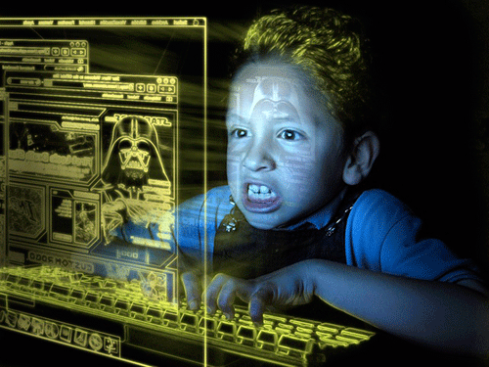
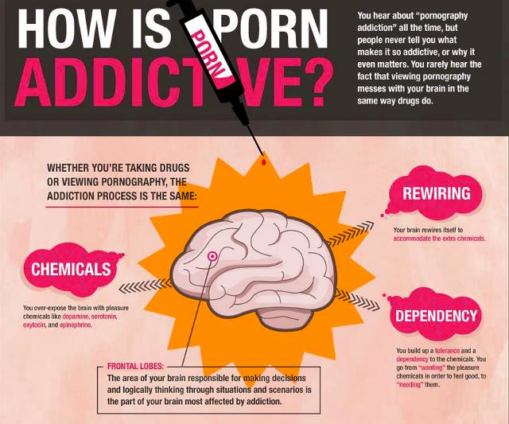



Slide 10
Routinely spending significant amount of time in chat rooms and private messaging with the sole purpose of finding cybersex
Physical and mental health problems
Tendency to commit sex based crimes
Engaging in explicit sex chat with other people online
Risk of teenage pregnancy
Viewing woman as sex objects
Looking at amateur or professional pornography sites
Depression
Taking part in online pornography, for example by posting nude photos or posing for a webcam
Waste of time
Restrict online time
Block pornography sites
Hiding your online interactions from your near ones
Feeling guilt or shame from your online use
Pursue other hobbies
Enlist help from family & friends

Slide 11
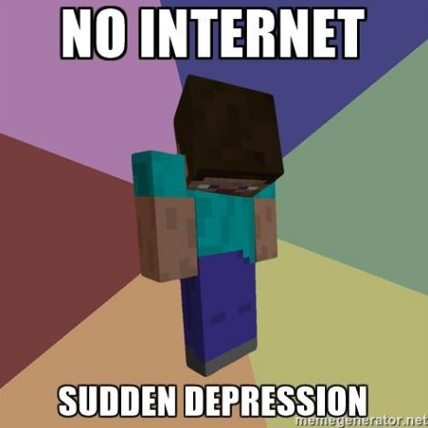
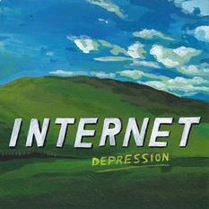

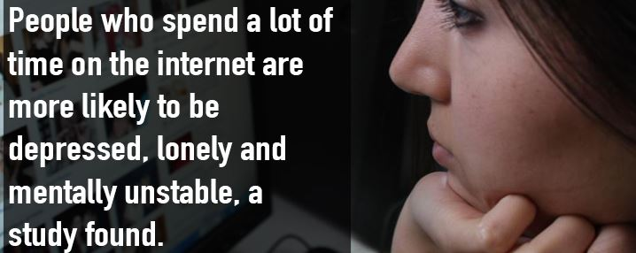
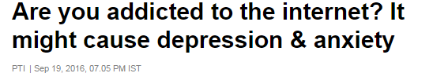



Slide 12








INTERNET
YOUR BODY
IMPACTS
!!! Continuous use of computers can trigger seizures in individuals sensitive to bright lights and contrasting color patterns

Slide 13

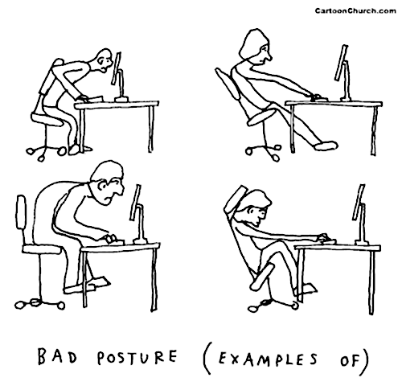
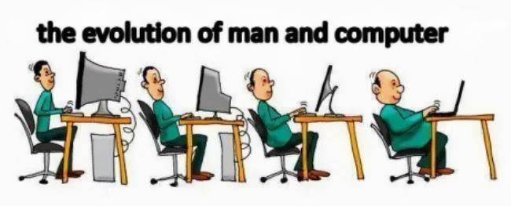

Slide 14

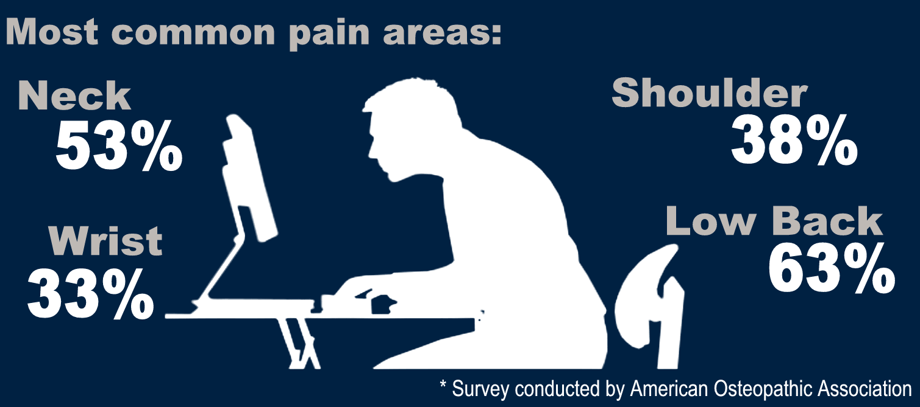
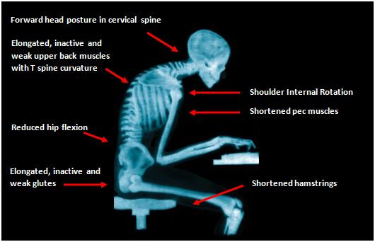

Slide 15
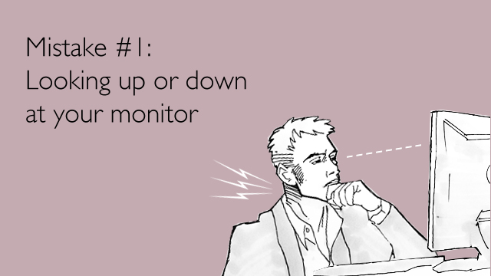
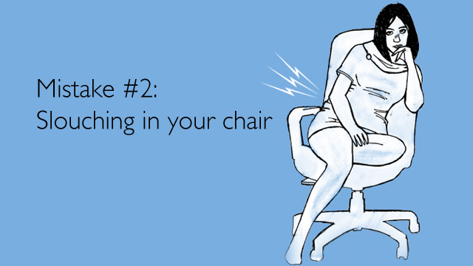
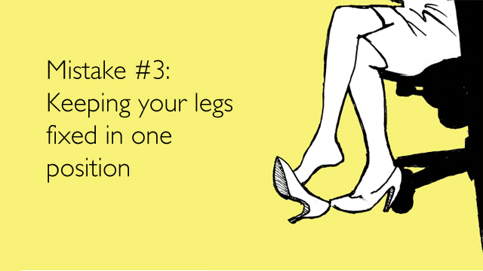

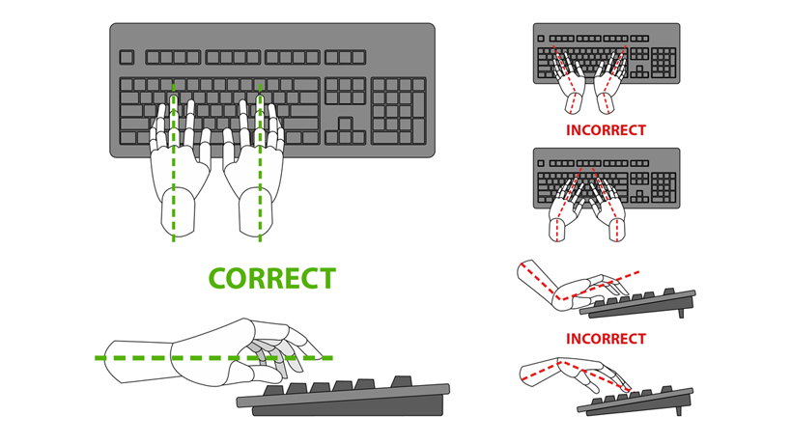
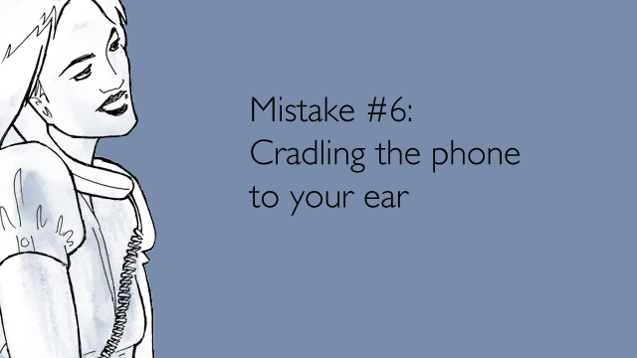
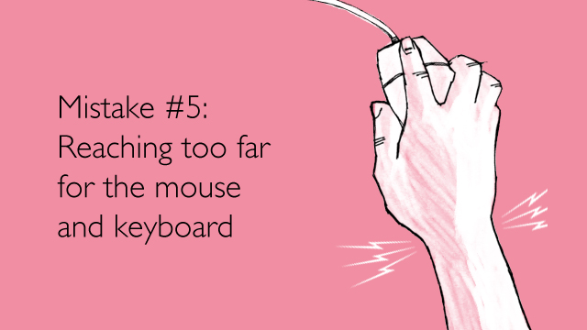
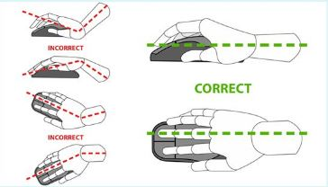
Courtesy - http://www.cbc.ca/

Slide 16
